Slide 1

Chapter Six
Tree Structure

Slide 2
Classifications of data structures:
Linear Data Structures: A data structure is said to be linear, if its elements form a sequence or linear list.
Example:
Arrays
Linked lists
Stacks and Queues.
Non-linear Data Structures: A Data Structure is said to be non-linear, if its elements do not form a sequence.
Example:
Trees and Graphs.

Slide 3
Introduction
A tree is a set of nodes and edges that connect pairs of nodes.
It is an abstract model of a hierarchical structure.
Unlike a real tree, tree data structures are typically depicted upside down, with the root at the top and the leaves at the bottom.
Each node can have a number of child nodes, and the parent and child nodes are connected by arcs.
The root is the top node that has no parent nodes.
The leaves of the tree are those that have no child nodes.

Slide 4
Trees Data Structures
Tree
  A way of representing hierarchical data.
  Consist of nodes with a parent-child relationship.
  Each node can have 0 or more children.
  A node can have at most one parent.
Rooted tree has the following structure:
  One node distinguished as root.
  Every node C except the root is connected from exactly other node P. P is C's parent, and C is one of P's children.
  There is a unique path from the root to each node.
  The number of edges in a path is the length of the path.

Slide 5

Example
University President
VPRA
VPAA
VPASA
VPCE
CCAE
CAS
CEME
Software Engineering
Electrical Engineering
Mechanical Engineering

Slide 6
Apps of Tree in Computer Science
Storing naturally hierarchical data - File system.
Organize data for quick search, insertion, deletion - Binary search tree.
Dictionary
Network Routing Algorithm. etc.

Slide 7
Tree Terminologies
Consider the following tree. ABEFGCDHIJKLM.
A
B
E
F
G
C
D
H
I
J
K
L
M

Slide 8
Tree Terminologies….
Root Node: a node with out a parent → A
Internal node: a node with at least one child
→A, B, F, I, J
External (leaf) node: a node without a child.
→ C, D, E, H, K, L, M, G
Ancestors of a node: parent, grandparent, grand-grandparent, etc of a node. Ancestors of K→ A, F, I
Descendants of a node: children, grandchildren, grand-grandchildren etc of a node.
Descendants of F→ H, I, J, K, L, M
Depth of a node: number of ancestors or length of the path from the root to the node. Depth of H → 2
Height of a tree: depth of the deepest node. → 3

Slide 9
Tree Terminologies….
A path through the tree to a node is a sequence of arcs that connect the root to the node.
The length of a path is the number of arcs in the path.
The level of a node is equal to the length of the path from the root to the node plus 1.
The root node is said to be at level 1 of the tree, its children at level 2, and so on.
The height of a tree is equal to the maximum level -1 of a node in the tree.

Slide 10
Tree Terminologies….
  Root ⇒ no parent
  Leaf ⇒ no child
  Interior ⇒ non-leaf
  Height ⇒ distance from root to leaf
Root node
Interior nodes
Height
Leaf nodes

Slide 11
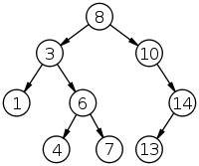
Example….
No. of nodes = 9
Height = 3
Levels = 1,2,3,4
Root Node = 8
Leaves = 1,4,7,13
Interior Nodes = 3,10,6,14
Ancestors of 6 = 3,8
Descendants of 10 = 14,13
Sibling of 1 = 6

Slide 12
Sub-tree: a tree consisting of a node and its descendants.
A
F
B
E
F
G
H
I
J
C
D
H
I
J
K
L
M
K
L
M

Slide 13
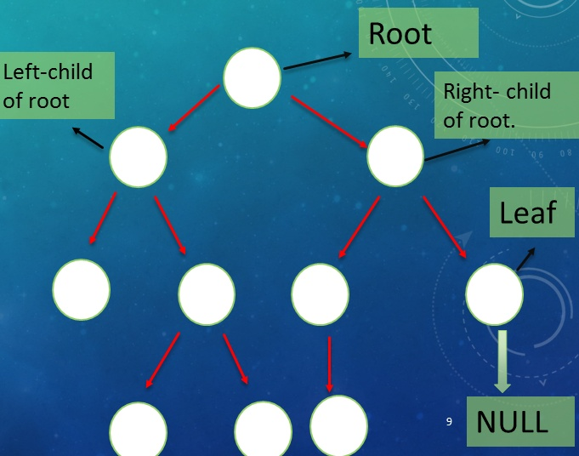
Binary Tree
  A tree in which each node has at most two children called left child and right child.
  A node have only left and right child or
  Only left child or
  Only right child.
  A leaf node has no left or right child.
  A leaf node has only NULL.

Slide 14
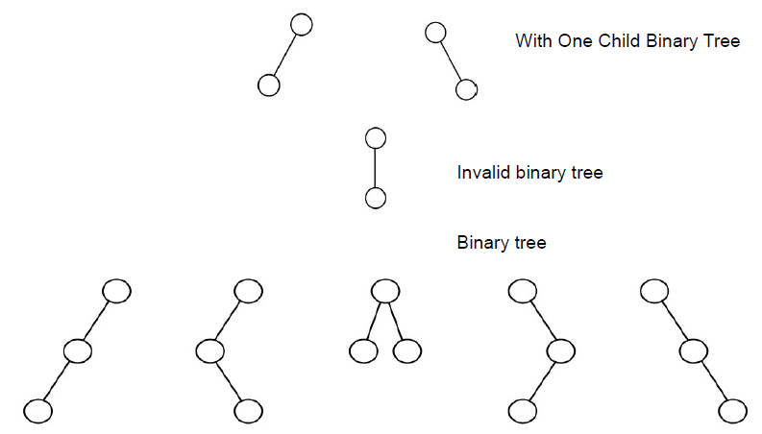
Binary Tree…..
Examples …

Slide 15
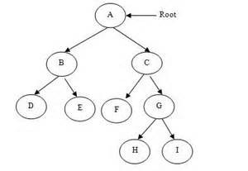
Types of Binary Tree
Strict binary tree/full binary tree
Each node has exactly either two or zero child.
Every non-leaf node has non-empty left and right sub trees.
A strict BT with n leaves always contains '2n-1' nodes.

Slide 16
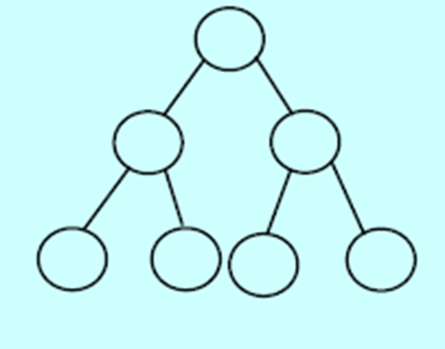
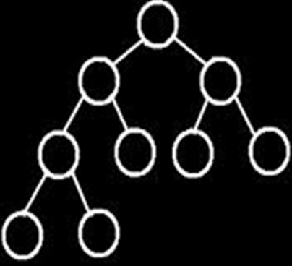
Types of Binary Tree
Balanced binary tree
  a binary tree where each node except the leaf nodes has left and right children and all the leaves are at the same level.
Complete binary tree
a binary tree in which the length from the root to any leaf node is either h or h-1 where h is the height of the tree.
The deepest level should also be filled from left to right.

Slide 17
Binary Search Trees (Ordered binary tree)
A binary search tree is either empty or in which every node contains a key and satisfied the conditions:
  The key in the left child of a node (if it exist) is less than the key in its parent node.
  The key in the right child of a node (if it exist) is greater than the key in its parent node.
  The left and right sub-trees of the root are again binary search trees.
  No two entries in a binary search tree may have a equal keys.

Slide 18
Binary Search Trees….
In short:
  Value at node
    Smaller values in left sub-tree
    Larger values in right sub-tree
  Example
    X > Y
    X < Z
Value of all the nodes in left sub-tree is lesser.
Value of all the nodes in right sub-tree is greater.
X
Y
Z

Slide 19
Examples 2 of Binary Search Tree
10
6
15
4
8
14
18
7
12
16
19
11
13

Slide 20
Binary Search Trees….
Examples
5
10
10
2
45
30
5
45
5
30
25
2
30
45
25
2
10
Not a binary search tree
25
Binary search trees
10>25?, False
30>45?, False

Slide 21
Binary Search Tree …(continued)
Note that more than one Binary Search Tree can be used to store the same set of key values.
For example, both of the following are BSTs that store the same set of integer keys:
2
3
1
3
2
4
1
4

Slide 22
Binary Search Tree …(continued)
The reason Binary-Search Trees are important is that the following operations can be implemented efficiently using a Binary Search Tree:
  Insert a key value.
  Determine whether a key value is in the tree.
  Remove a key value from the tree.
  Print all of the key values in sorted order.

Slide 23
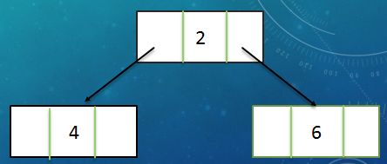
Binary Tree Implementation (using LL)
Tree is a data structure similar to linked list.
Instead of pointing to one node each node can point to a number of nodes.
Data Structure of a Binary Tree
struct node{
//declaration of data fields
node *leftChild,
node *rightChild;
};
node *rootPtr = NULL;
struct node{
int key;
node *left,
node *right;
};
node *rootPtr=NULL;
Example:

Slide 24
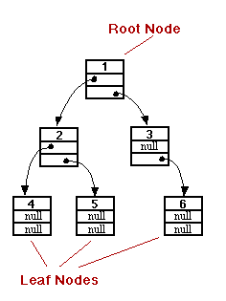
Binary Tree …(continued)

Slide 25
Data Structure of Generic Tree (N-ary) Tree
Each node can have no child, one child, two child or more than two child - called generic tree, tree of a general kind.
How to design data structure for such a tree?
Possible solution may be:
struct node{
int data;
node *firstchild;
node *secondchild;
node *threechild;
node *fourchild;
node *fivechild;
};
node *rootPtr
…But wait, this structure has problem?

Slide 26
Data Structure of Generic Tree (N-ary) Tree
We don’t know the exact number of children for each node.
  Wastage of memory by allocating extra child since we are not using all the pointers in all the cases.
Possible solution is:
  At each node there should be a link between all the children of same parent (sibling).
  Also, remove all the link from parent to their child except first child.
struct node {
int data;
node *firstchild;
node *nextsibling;
};
node *rootPtr = NULL;

Slide 27
Operations on Binary Search Tree
Basic Operations:
  Inserting an element into tree
  Deleting an element from tree
  Searching for an element
  Traversing the tree
Auxiliary operations:
  Finding-size of tree
  Height of tree, etc

Slide 28
BST – Insertion
When a node is inserted the definition of binary search tree should be preserved!
Suppose:
  rootPtr -points to root node
  newPtr -points new node
Case 1: There is no data in the tree
  (i.e. rootPtr is NULL)
  The node pointed by newPtr should be made the root node.
Case 2: There is data
  Search the appropriate position.
  Insert the node in that position.

Slide 29
Algorithm
  Perform search for value X.
  Search will end at node Y (if X is not in the tree).
  If X < Y, insert new leaf X as new left sub-tree for Y.
  If X > Y, insert new leaf X as new right sub-tree for Y.
  N.B: Insertions may unbalance the tree.

Slide 30
Algorithm…
1. Input the data to be pushed and root node of the tree.
2. newPtr = Create a New Node, parentPtr = rootPtr
3. If (parentPtr == NULL)
  parentPtr = newPtr
4. Else if (data < parentPtr ->info)
//parentPtr ->info :data part
    parentPtr = parentPtr->left
    GoTo Step 4
5. Else if (data > parentPtr->info)
    parentPtr = parentPtr->right
GoTo Step 4
6. If (data< parentPtr->info)
    parentPtr->Left = newPtr
7. Else if (data > parentPtr->info)
parentPtr ->right = newPtr
8. Else
display (“duplicate node”)
exit
9. newPtr->info = data
10. newPtr->left = NULL
11. newPtr->right = NULL
12. exit

Slide 31
Example 1
We want to insert a node (that stores 17) pointed by InsNodePtr.
Case 1: There is no data in the tree:
(i.e. RootNodePtr is NULL)
The node pointed by InsNodePtr should be made
root node.
InsNodePtr
RootNodePtr
RootNodePtr
17
17

Slide 32
Case 2: There is data
  Search the appropriate position.
  Insert the node in that position.
InsNodePtr
RootNodePtr
RootNodePtr
InsertBS T(RootNodePtr, InsNodePtr) ➔
17
10
10
6
6
15
15
4
8
14
18
4
8
14
18
7
12
16
19
7
12
16
19
11
13
11
13
17

Slide 33
Example 2
Insert ( 20 )
10 < 20, right
30 > 20, left
25 > 20, left
Insert 20 on left
10
5
30
2
25
45
20

Slide 34
Implementation for BST - Insertion
//insert in to a binary search tree, RNP=rootnodeptr, NNP=newnodeptr
Node *RNP, *NNP;
void insertBST(Node *RNP, Node *NNP){
int inserted=0;//a flag to check inserted or not
Node *temp;
temp=RNP;
if(temp==NULL)
{
temp=NNP;
RNP=NNP;}
else{
while(inserted==0){
if(temp->num>NNP->num){
if(temp->left==NULL){
temp->left=NNP
inserted=1;}
else
temp=temp->left;}

Slide 35
Implementation for BST – Insertion…
else { //if temp->num <NNP->num
if(temp->right==NULL){
temp->right=NNP;
inserted=1;}
else
temp=temp->right
}//else
}//end of while
}//end of function

Slide 36
BST - Deletion
Deletion of a node from a binary search tree can be
more problematic.
The difficulty of the operation depends on the position
of the node in the tree. There are three cases:
  The node is a leaf. This is the easiest case to deal with. The appropriate pointer of its parent is set to null and the node deleted.
  The node has one child. This case is also not complicated. The appropriate pointer of its parent is modified to point to the child of the node.
  The node has two children. There is no simple way to delete nodes like this. The following sections discuss two possible ways of dealing with this situation. Eg-Deleting a root node having two child

Slide 37
Deletion by Merging
One way of deleting nodes that have two children is called deletion by merging.
This algorithm works by merging the two subtrees of the node and attaching the merged tree to the node’s parent.
In binary search trees, every value in the left subtree is less than every value in the right subtree, so if we can find the largest value in the left subtree, then we can attach the right subtree as the right child of this node, and still preserve the ordered nature of the tree. This process is illustrated in the following figure.
To find the largest value in the left subtree we need only keep tracking the right child pointer until a null is encountered.
Symmetrically, this algorithm can also work by finding the smallest value in the right subtree, and attaching the left subtree to it.

Slide 38
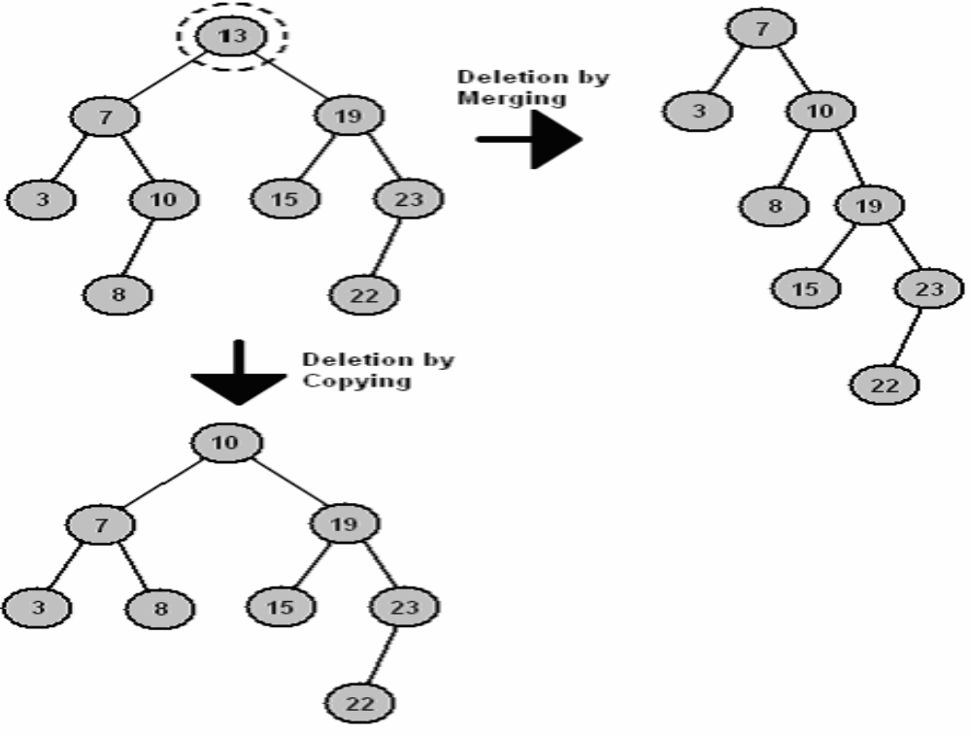

Slide 39
Deletion by Copying
Deletion by copying works in a similar fashion to deletion by merging.
  First, we find the largest value in the left subtree.
  Next, we copy this node, so that it replaces the node being deleted.
This process is illustrated in the above figure.
  The 10 node is a valid new root to the tree because it is greater than all nodes in the left subtree, and less than all nodes in the right subtree.
A slight complication with this algorithm can occur if the largest value in the left subtree has a left child.
In this case, the left child is attached to the nodes parent instead.

Slide 40
Algorithm
Perform search for value X
If X is a leaf, delete X
Else // must delete internal node
  a) Replace with largest value Y on left subtree
  OR smallest value Z on right subtree
  b) Delete replacement value (Y or Z) from subtree

Slide 41
Example Deletion (Leaf)
Delete ( 25 )
10
10 < 25, right
30 > 25, left
25 = 25, delete
10
5
30
5
30
2
25
45
2
45

Slide 42
Example Deletion (Internal node)
Delete ( 10 )
10
5
5
5
30
5
30
2
30
2
25
45
2
25
45
2
25
45
Replacing 10 with largest value in left subtree
Replacing 5 with largest value in left subtree
Deleting leaf

Slide 43
Example Deletion (Internal node)
Delete ( 10 )
10
25
25
5
30
5
30
5
30
2
25
45
2
25
45
2
45
Replacing 10 with smallest value in right subtree
Deleting leaf
Resulting tree

Slide 44
RootNodePtr
To be deleted
10
6
16
5
8
13
23
2
7
9
14

Slide 45
The binary search tree after deleting Node 6.
RootNodePtr
10
Deleted
6
16
8
13
23
temp2
7
9
14
5
2

Slide 46
Implementation (deletion by copy)
PDNP=Previous Node of the "to be deleted Node"
void deleteBST(Node *RNP, Node *PDNP,int x){
Node *DNP;//DNP=DeleteNodePointer
if(RNP==NULL)
cout<<"Data Not Found";
else if(RNP->num > x)
deleteBST(RNP->left, RNP, x);
else if(RNP->num < x)
deleteBST(RNP->right, RNP, x);
else //if RNP->num==x {
DNP=RNP;
if((DNP->left==NULL)&&(DNP->right==NULL)){//leaf node
if (PDNP->left==DNP)
{
PDNP->left=NULL;
delete DNP;
}
else{
PDNP->right==NULL;
delete DNP;
}}

Slide 47
Implementation….
  else if(DNP->left!=NULL){
PDNP=DNP;
DNP=DNP->left;
while(DNP->right!=NULL){
PDNP=DNP;
DNP=DNP->right;
}
RNP->num=DNP->num;
deleteBST(DNP,PDNP,DNP->num);
}//else
else//has only a right child
{
PDNP=DNP;
DNP=DNP->right;
while(DNP->left!=NULL){
PDNP=DNP;
DNP=DNP->left;
}
RNP->num=DNP->num;
deleteBST(DNP,PDNP,DNP->num);
}//else } }

Slide 48
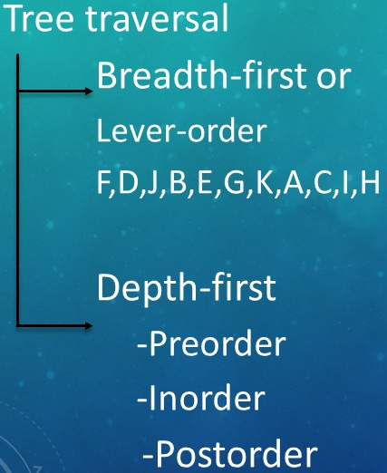
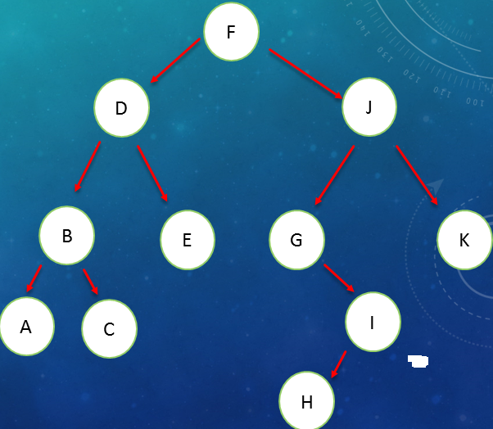
Traversing Binary Trees
Tree traversal is one of the most common operations performed on tree data structures.
It is a way in which each node in the tree is visited exactly once in a systematic manner.
Level - order

Slide 49
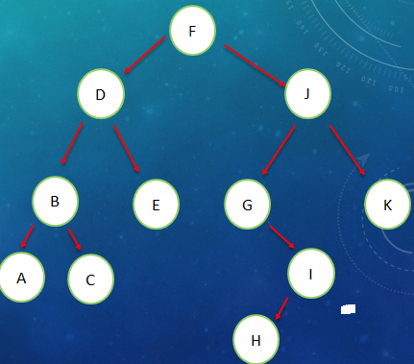

Pre Order Traversal (Recursive)
Pre order traversal - traversing binary tree in the order of parent, left and right (PLR)
Steps:
  Visit the root node
  Traverse the left sub tree in preorder
  Traverse the right sub tree in preorder

Slide 50

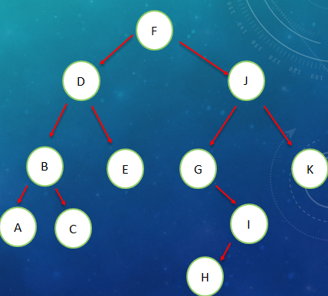
In Order Traversal (Recursive)
In order traversal - traversing binary tree in the order of left, parent and right (LPR) , prints the node values in ascending order:
Steps: 1. Traverse the left sub tree in-order
2. Visit the root node
3. Traverse the right sub tree in-order
[The left sub tree is traversed recursively, before visiting the root. After visiting the root the right sub tree is traversed recursively, in order fashion.]

Slide 51
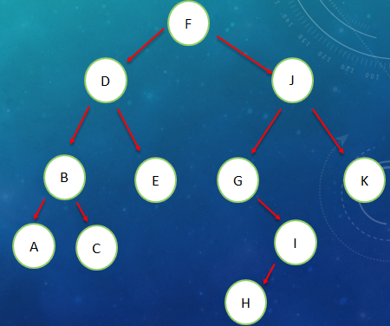
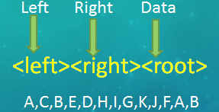
Post Order Traversal (Recursive)
Post order traversal - traversing binary tree in the order of left, right and parent (LRP).
Steps:
  Traverse the left sub tree in post order
  Traverse the right sub tree in post order
  Visit the root node

Slide 52
Example: 1
RootNodePtr
10
6
15
4
8
14
18
7
12
16
19
11
13
17

Slide 53
Preorder traversal: 10, 6, 4, 8, 7, 15, 14, 12, 11, 13, 18, 16, 17, 19
Inorder traversal: 4, 6, 7, 8, 10, 11, 12, 13, 14, 15, 16, 17, 18, 19
Used to display nodes in ascending order.
Postorder traversal: 4, 7, 8, 6, 11, 13, 12, 14, 17, 16, 19, 18, 15, 10
Application of binary tree traversal
Store values on leaf nodes and operators on internal nodes:
  Preorder traversal: - used to generate mathematical expression in prefix notation.
  Inorder traversal: - used to generate mathematical expression in infix notation.
  Postorder traversal: - used to generate mathematical expression in postfix notation.

Slide 54
Example: 2
+
–
+
A
*
D
/
B
C
E
F
Preorder traversal: + – A * B C + D / E F → Prefix notation
Inorder traversal: A – B * C + D + E / F → Infix notation
Postorder traversal: A B C * – D E F / + + → Postfix notation

Slide 55
Pre Order Traversal -Implementation
void preorder (node *CurrNodePtr)
{
if(CurrNodePtr ! = NULL)
{
cout<< CurrNodePtr->data;
// or any operation
preorder(CurrNodePtr->left);
preorder(CurrNodePtr->right);
}
}
+
- %
A * * 4
/ 2 D 5
C 5
Output: + - A * / C 5 2 % * D 5 4

Slide 56
In Order Traversal -Implementation
void inorder (node *CurrNodePtr){
if(CurrNodePtr ! = NULL){
inorder(CurrNodePtr->left);
cout<< CurrNodePtr->data;
inorder(CurrNodePtr->right);
}
}
+
- %
A * * 4
/ 2 D 5
C 5
Output: A – C / 5 * 2 + D * 5 % 4

Slide 57
Post Order Traversal -Implementation
void postorder (node *CurrNodePtr){
if(CurrNodePtr ! = NULL){
postorder(CurrNodePtr->left);
postorder(CurrNodePtr->right);
cout<< CurrNodePtr->data;
}
}
+
- %
A * * 4
/ 2 D 5
C 5
Output: A C 5 / 2 * - D 5 * 4 % +

Slide 58
BST- Search
To search a node (whose Num value is Key) in a binary search tree (whose root node is pointed by n).
One of the three traversal methods can be used.
      node *find( node *n, int key)
      {
      while (n != NULL) {
      if (n->data == key)// Found it
      return n;
      if (n->data > key)//In left subtree
      n = n->left;
      else // In right subtree
      n = n->right;
      }
      return null;
      }
      //call function
      node * n = find( root, 5);

Slide 59
Example Search
find ( root, 2 )
root
10 > 2, left
5 > 2, left
2 = 2, found
10
5
5 > 2, left
2 = 2, found
5
2
45
30
2
45
30
25
10
25

Slide 60
Example Search
find (root, 25 )
5
10
5 < 25, right
45 > 25, left
30 > 25, left
10 < 25, right
25 = 25, found
45
5
30
2
2
25
45
30
10 < 25, right
30 > 25, left
25 = 25, found
10
25

Slide 61
Finding Minimum value in a BST
We can get the minimum value from a Binary Search Tree, by locating the left most node in the tree. Then after locating the left most node, we display the value of that node.
RootNodePtr
Example
10
6
15
4
8
14
18
7
12
16
19
11
13
17

Slide 62
RootNodePtr
10
Minimum
6
15
4
8
14
18
7
12
16
19
11
13
17

Slide 63
Implementation: Finding Minimum value in a BST
int findMin(Node *RootNodePtr)
{
if(RootNodePtr == NULL)
return -1;
else if(RootNodePtr->Left == NULL)
return RootNodePtr ->Num;
else
return findMin(RootNodePtr->Left);
}

Slide 64
Finding Maximum value in a BST
We can get the maximum value from a Binary Search Tree, by locating the right most node in the tree. Then after locating the right most node, we display the value of that node.
RootNodePtr
10
6
15
Maximum
4
8
14
18
7
12
16
19
11
13
17

Slide 65
Implementation: Finding Maxiumu value in a BST
int findMax(Node *RootNodePtr) {
if(RootNodePtr == NULL)
return -1;
else if(RootNodePtr ->Right == NULL)
return RootNodePtr ->Num;
else
return findMax(RootNodePtr ->Right);
}

